Slide 1
Overview of System refresh

Slide 2
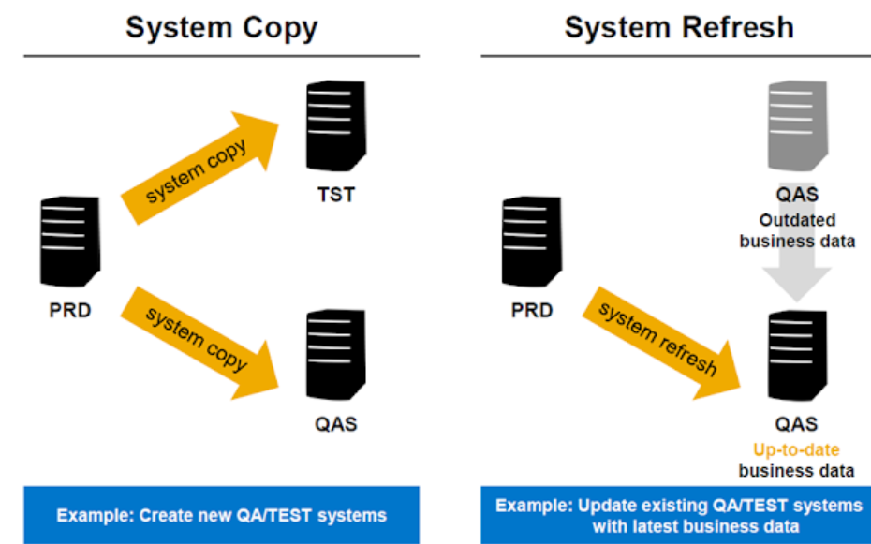
What is system refresh/copy?
System refresh is nothing but moving the source system data to target system. Generally system refresh performed on quality/sandbox system using the data to refresh from the production system for testing purpose.
If the SAP System already exists it is known as System Refresh.
if the System doesn't exists and you are building a new system using the source system it is known as a system copy.

Slide 3
Need for System Refresh
Since the production system is live system hence it consist live and up-to-date data of the business
When anything new need to be tested that should be performed in quality system and to test the scenario’s with the latest data quality system should be in sync with production system. As per SAP standards system refresh need to be done after 3 months

Slide 4
Types of System Refresh
Homogeneous system refresh
  Operating system and Database system are same on the both source and target systems
Heterogeneous System Refresh
Operating system or Database system of the target system is different from the source system. This is also called as OS/DB migration. To perform this activity we need to have migration key that is provided by SAP.

Slide 5
Methods of System Refresh
Backup and Restore Method
First we have to take the backup of the source DB and then we can restore the same backup file over the source system using control files.
Export / Import Method
In this method using SWPM first we have to take Export of source database system. Once export is completed then using same export we have to import the database over target system.

Slide 6
Backup and Restore Method
Take a backup of Source system (PRD)
Then Restore it on target system (QAS).
oraqas>brrestore –m full –b <backup>.aft –c
If backup is online (.ant)--> then restore & recover it.
If Backup is offline (.aft)-->only Restore it. (here we are using offline backup)
Once the restore is complete, After that create a trace file at source system (PRD). SQL>alter database backup controlfile to trace;
Copy that trace file to target system QAS & edit it in target system.
In trace file:Locate “STARTUP NOMOUNT” From current line till end delete everything.
Then change SID PRD to QAS (:1,$S/PRD/QAS/g)
Change Reuse to set
Change Noresetlogs to resetlogs
Change Archivelog to Noarchivelog
Now save this file as <tracefilename>.sql at location /oracle/QAS/saptrace/usertrace
Once you complete the above step, create controlfile using trace file in target system QAS.
SQL>@<tracefilename>.sql
SQL> alter database open resetlogs;

Slide 7
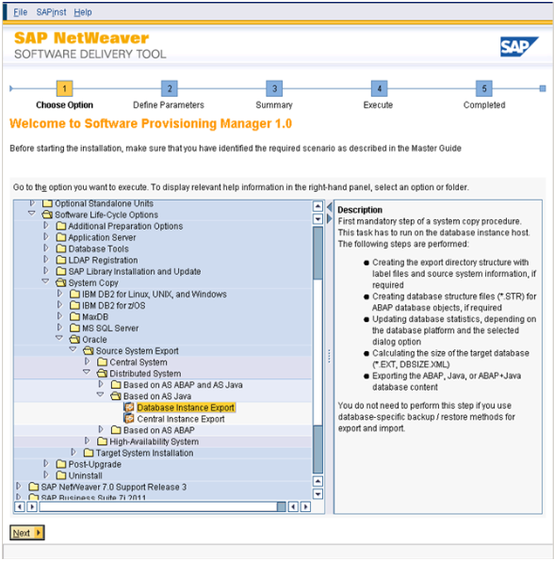
Export / Import Method

Slide 8
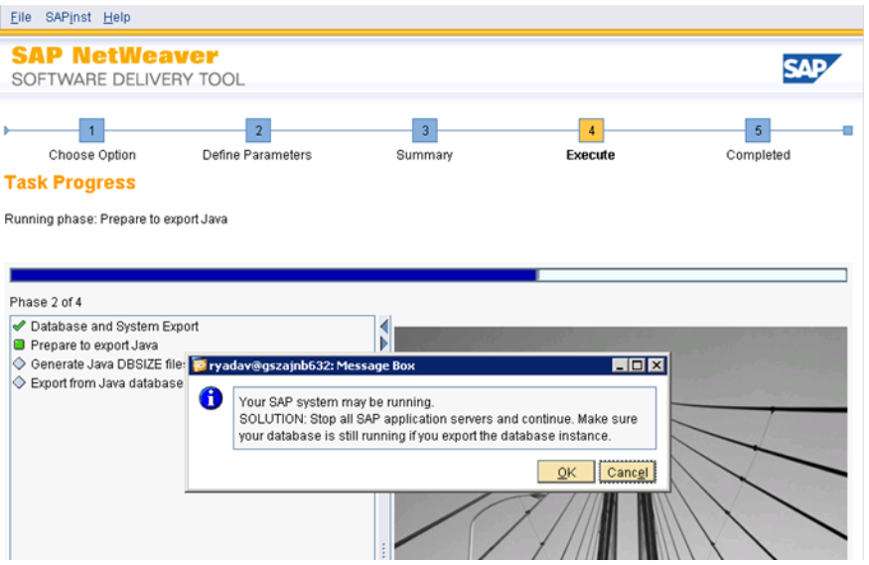

Slide 9
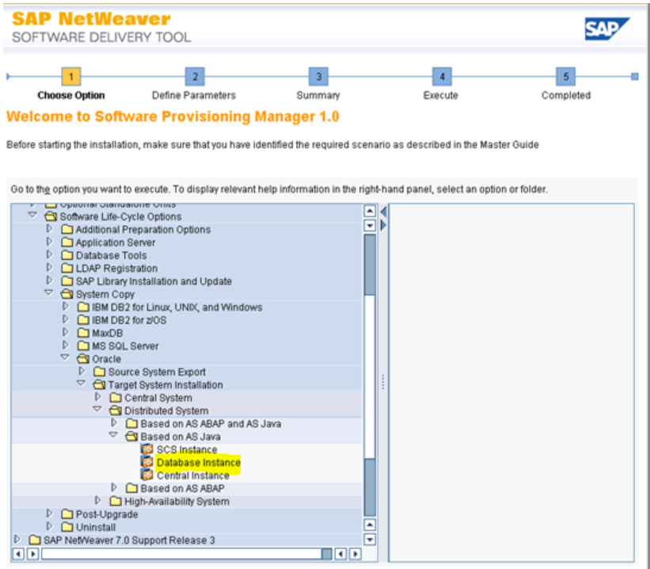

Slide 10
For Export and Import method follow the below links:
https://blogs.sap.com/2013/12/18/enterprise-portal-system-refresh-document-part-1/
https://blogs.sap.com/2013/12/16/enterprise-portal-system-refresh-document-part-2/

Slide 11
Phases of Refresh
Below are the phases for the system refresh:
Pre-checks for the source and target system
Pre refresh activity
Database Restore and Recovery
Post refresh activity

Slide 12
Prerequisite for System Refresh
Study on the Current Utilization of resources on Target system and Source System.
Check the available CPU's & memory on the Target hardware and Source System.
Compare the database sizes of Target hardware and Source System.
Compare the existing FS & current utilization of the same on Target system and Source System.
Study the systems integrated to target system in SM59( Configuration of RFC connection). There are three ways to do it:
1.Take Screenshots of the Configurations.
2.By doing Table Export(using R3Trans Utility)
3.By saving tables in TOC (transport of copies using SE01)
Some interfaces are connected to TARGET or other (mainly to PI) on a special requirement. Make a note of it.
Compare the software versions of SAP application on both the systems.
Make a note of any additional add-ons on the systems if any from the above step.
Compare the Oracle Database & client versions.(Note: It need to be done carefully if version doesn’t match we can’t proceed forward with it)

Slide 13
Check the existing SLD settings.(SLDAPICUST)
Check all the existing developments, open transports.
In this we need to check for 2 things:
  Open Transport: Contact the Owner of TR and ask to take appropriate action or else administrator needs to delete it.
  Transport in release state(Make a backup of in-flight transport list).
Number of Open Transports; Local Transports - Quick analysis on the transports.
Consolidate all the list and send it across to the related projects (optional).
Prepare a list if anything has to be retained.
Check for a FS on the DB host OS level to store the backup of Production .
Check if the schema name is same on Source as well as Target.

Slide 14
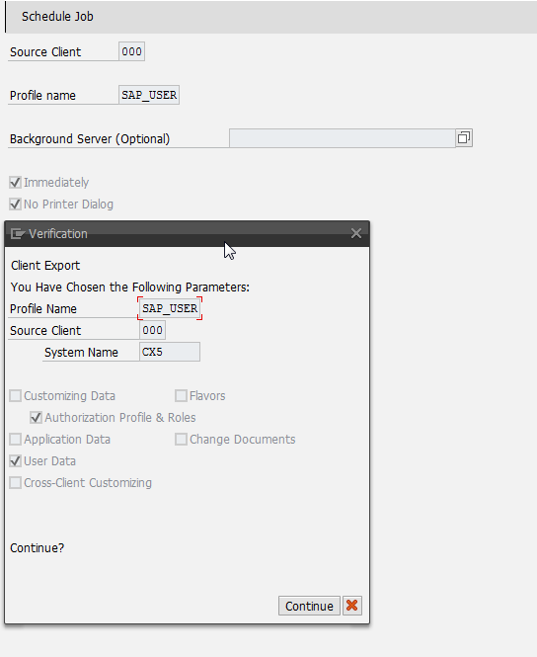
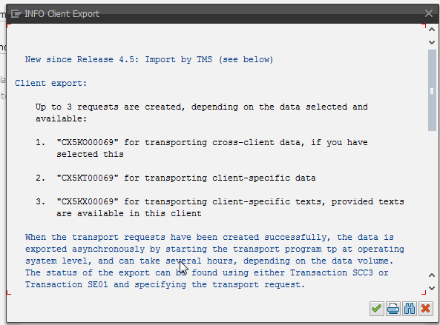

Pre Refresh Activity
1) Export of User Master

Slide 15
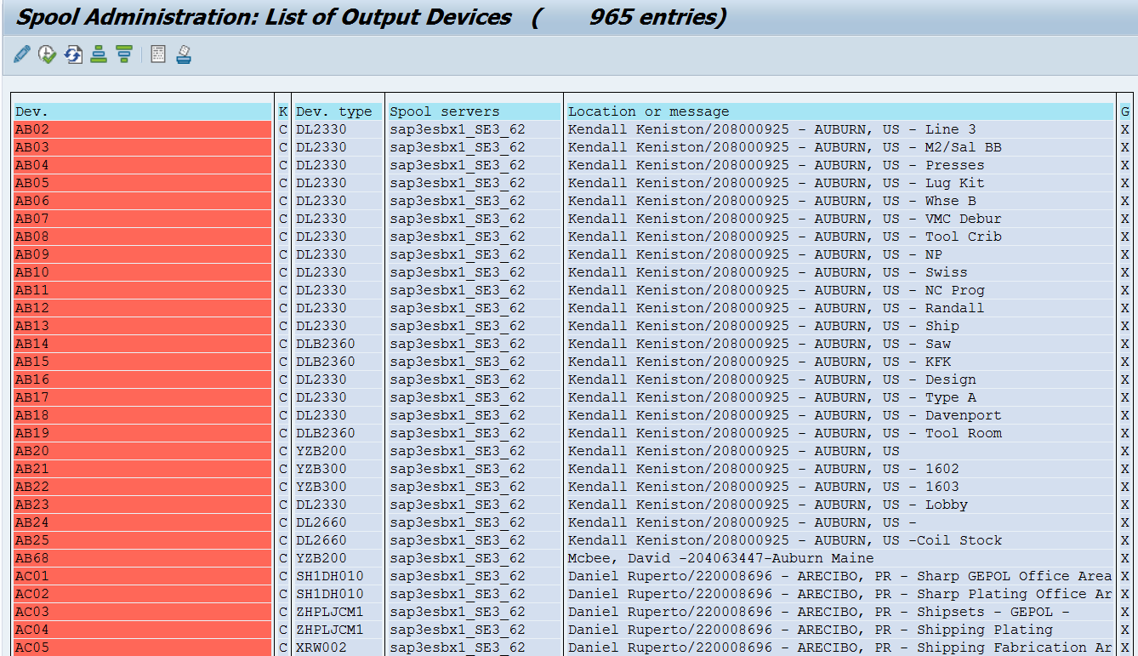
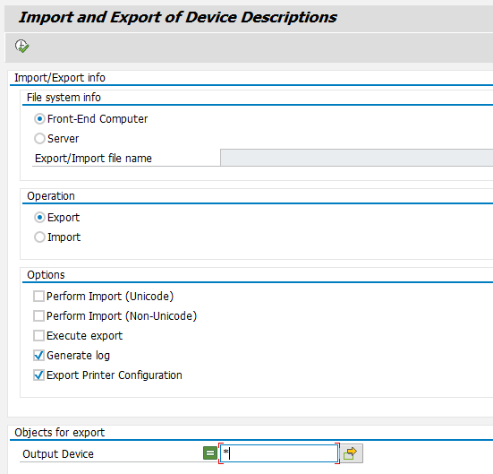
2) Export Printer Definition

Slide 16
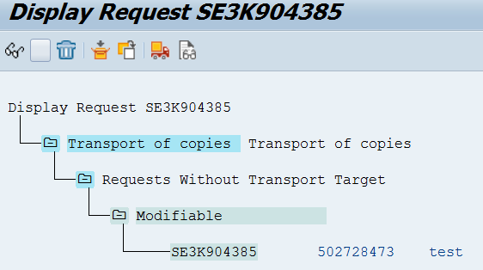
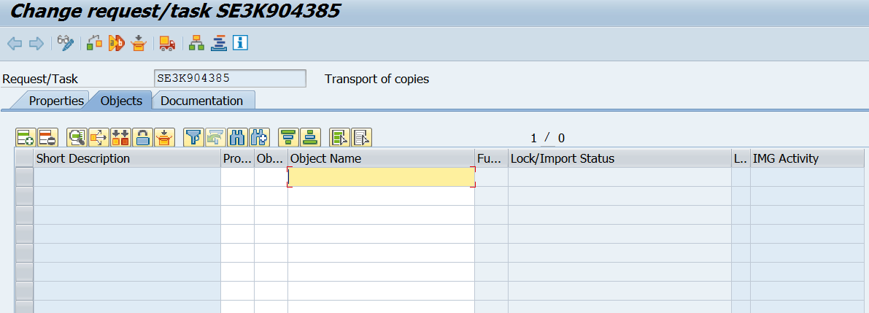
3) Export RFCs/Partner Profiles/Logical Systems by creating TR
Below are the tables to export:
RFCDES, RFCDOC,RFCCHECK, EDIPORT, EDP12, EDP13, EDP21, EDPP1, TBD00, TBDLS, etc.

Slide 17
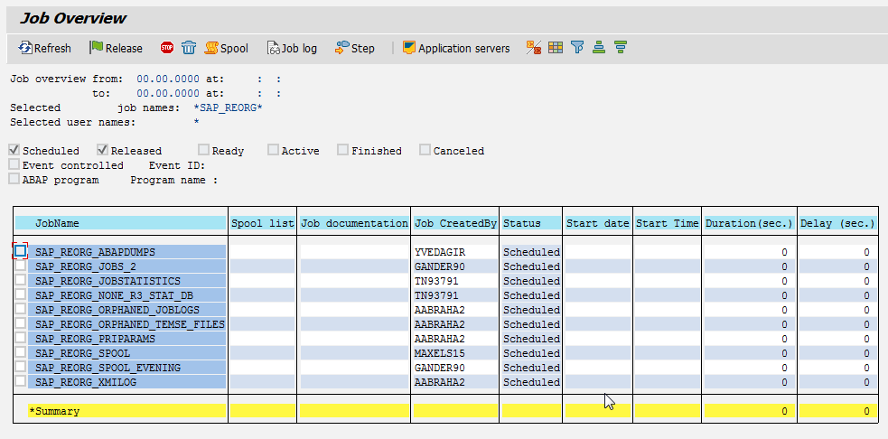
4) Clean up Job Log Directory

Slide 18
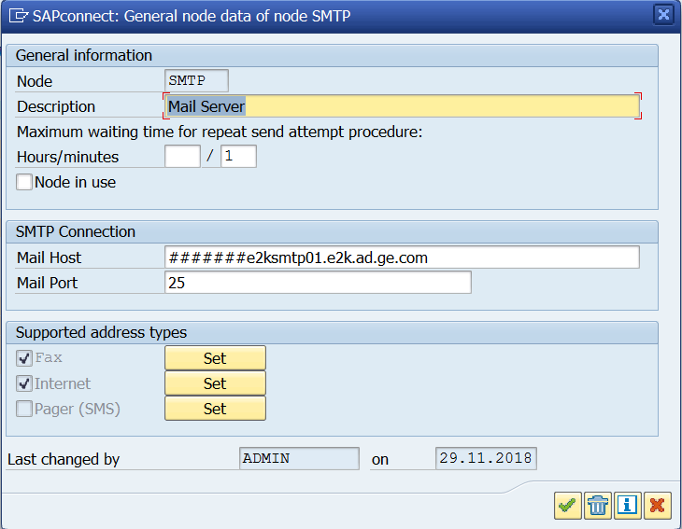
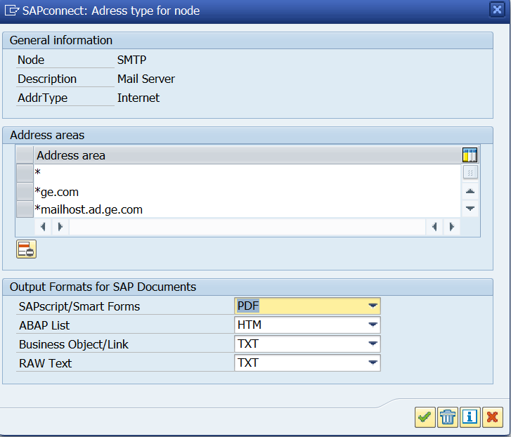
5) Export SCOT Configuration

Slide 19
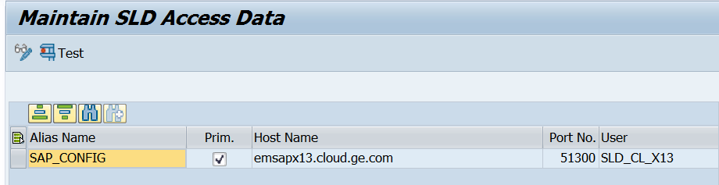
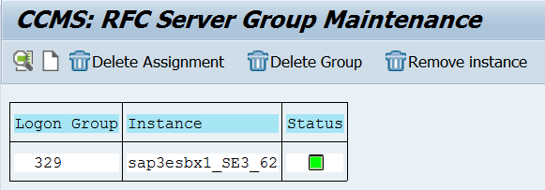
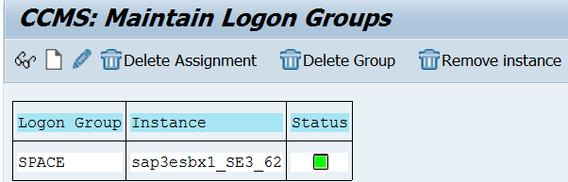
6) Export SLDAPICUST configuration
7) Logon Group Details

Slide 20
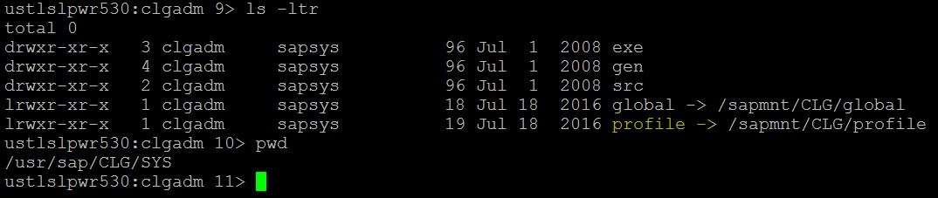
8) Export Profile
Go to profile path /usr/sap/<SID>/SYS and take copy of profile directory.
9) Take snaps of STMS configuration
10) Take snap of tRFC and Outbound qRFC Configuration from SMQS and SMQR
11) Take DB13 snap for backup strategy details
12) Take snap of batch job server configuration using SM61
13) Take snap of SMICM

Slide 21
  14) Take STRUST snap
  15) Take operation modes snap using SM63 and RZ03
  16) Take snap of partner profiles(LS) using WE20
  17) Take snap of IDOC ports using WE21
  18) Secure the required passwords of OS users ; <sidadm>
  19) Secure the required passwords of Application Users ; DDIC/000
  20) Secure the required passwords of DB users; SYSTEM; SCHEMA users
  21) Download required license for Target and have it stored on OS Level
  22) Send out a communication to all required stakeholders about the downtime
  23) Set a system message SM02 with the timelines & unavailability

Slide 22
Database Restore and Recovery
Stop SAP Application, Database and Listener.
Stop the SAP application from OS level using Command “stopsap R3”
Delete the existing datafiles from Target database and rename current control files on target system
Restore backup
Recover the database
Create Control file.
Start SAP application
Lock all the production users
Set SAP background process to 0 and Suspend all the jobs.
Restart SAP application

Slide 23
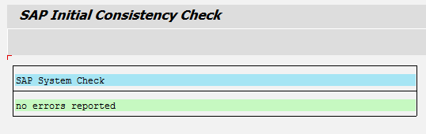
Post Refresh Activity
1) Change parameters before start SAP SYSEM - rdisp/btctime = 0 and rdisp/wp_no_btc=0
2) Start the Sap application server
3) Apply SAP LICENSE
4) Execute the report BTCTRNS1 in SE38 to suspend the jobs in target system
5) Disable Fax and Email in SCOT and SM59 by disabling the node
6) Perform initial consistency check

Slide 24
7) Make the STMS configuration using SE06 and STMS(using the snaps taken in pre-refresh activity)
8) RDDNEWPP -- to schedule the job RDDIMPDP in system for transport. Run report in client 000
9) Using Tcode SPAD to Import printers in target system which we exported during pre-refresh
10) Import the TR of RFCs/Partner Profiles/Logical Systems which was created during the pre-refresh activity
11) Excute report BTCTRNS2 in se38 to release the suspended jobs
12) Revert the profile directory with the backup of it taken during the pre-refresh activity. (Path= usr/sap/<sid>/sys)
13) RZ10 – import profiles from active servers
14) Delete the operation mode of source system from RZ03 and make similar as snap taken of RZ03 during pre-refresh.

Slide 25
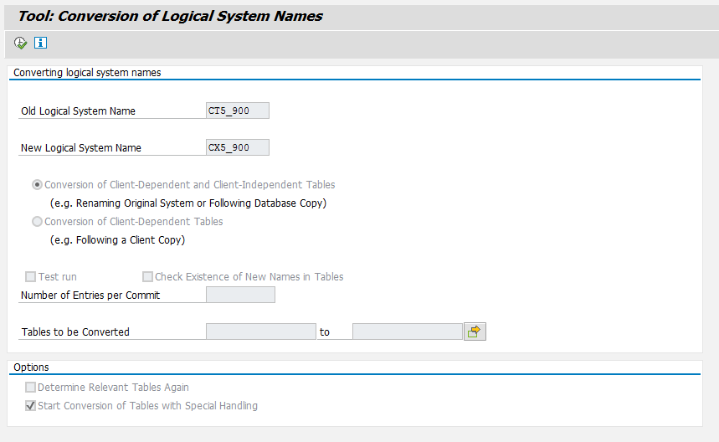
15) Delete the instance of source system from the SMLG tcode.
16) Logical System Conversion – BDLS

Slide 26
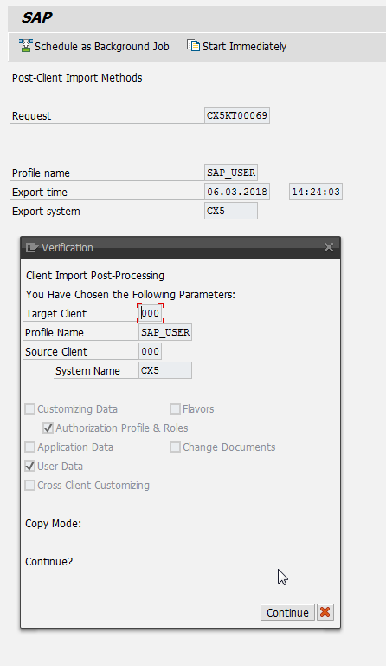
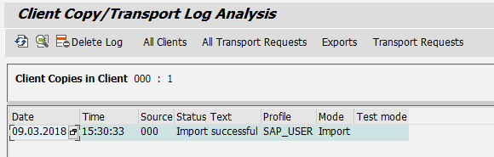
17) Run the report RSBCS_REORG to clear the send request from the SOST
18) Run the report RSTRFCQD to clear the outbound queues
19) Run the report RSPO0041 to clear the spool entries.
20) Run the tcode SGEN to the Generate load
21) Import the User master TR created during pre-refresh and once import successful perform action on tcode SCC7.

Slide 27
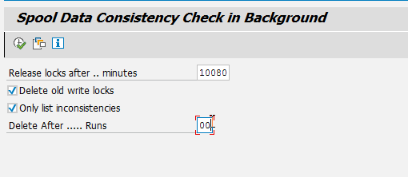
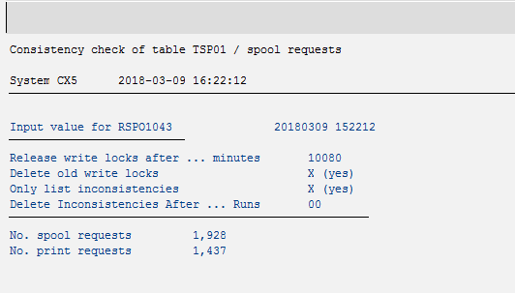
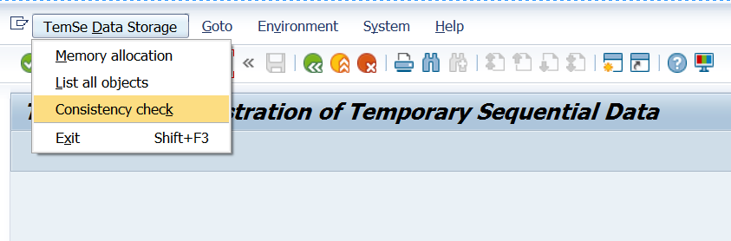
22) Spool consistency check
23) TemSe consistency check

Slide 28
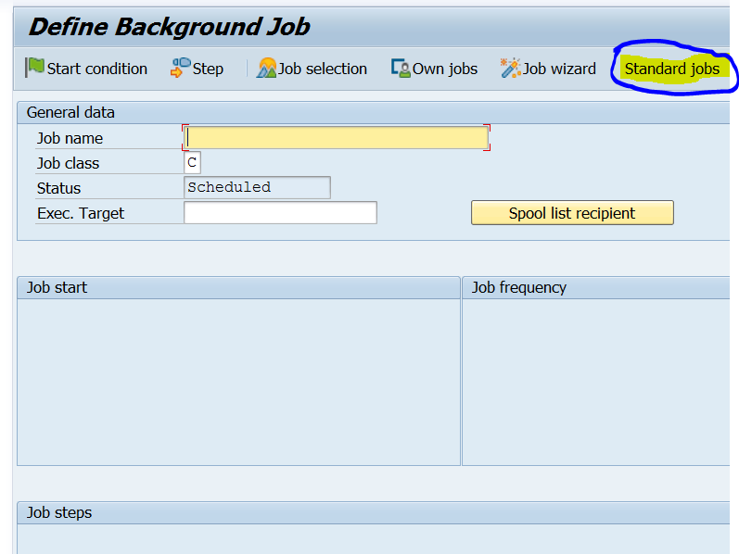
24) Run the report RSBTCDEL to delete the finished and cancelled jobs
25) Schedule the SAP standard jobs from SM36
26) Import any add-ons (if any)

Slide 29
27) Import any TR's (provided by Projects i.e. in-flight transports)
28) Configure Database Backup
29) Update SAP system logon screen message
29) Release system to users

Slide 30
Q & A

